Slide 1
Gantt Chart
9/26/2018

Slide 2
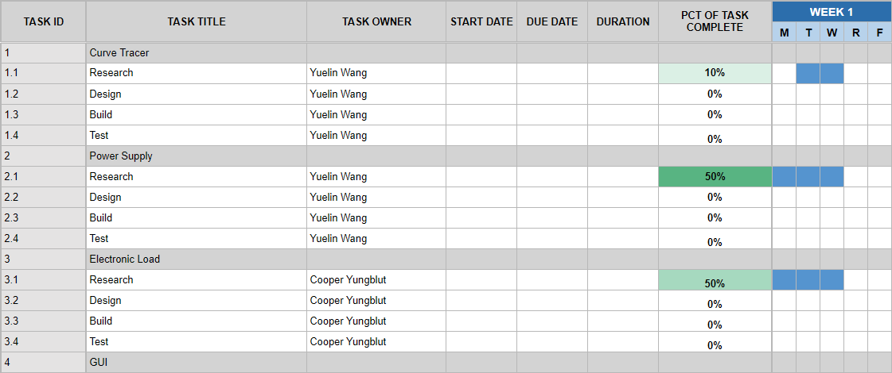
Initial Gantt Chart

Slide 3
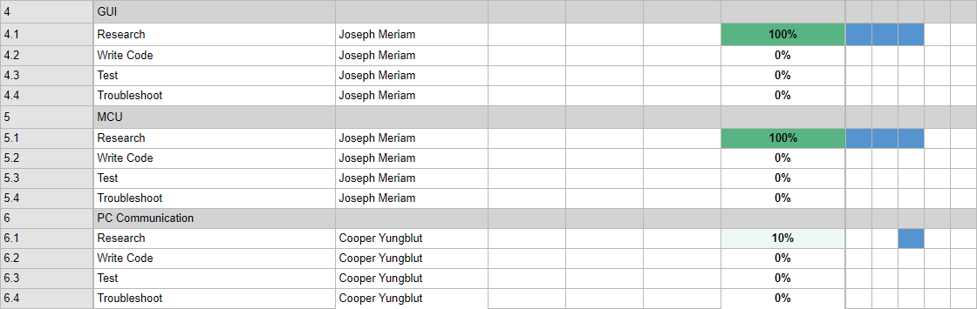
Initial Gantt Chart p2

Slide 4
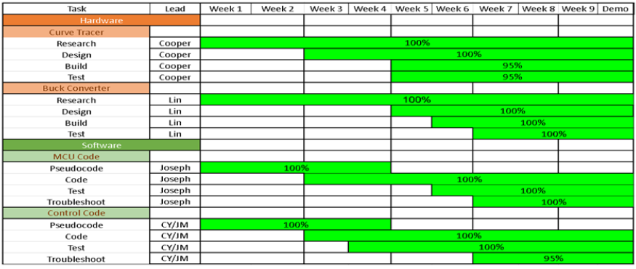
Final Gantt Chart (Completely Redone)

